Slide 1
CS/CpE/EE/BIC Joint Senior Design Program BEAT: Branding and Entrepreneurship of Assistive Technology for Social Good
CSc 59866/59867 Capstone I/II Fall 2020-Spring 2021
Project Showcases
Zhigang Zhu, Kayser Chair Professor of Computer Science, GSOE, CCNY
Gerardo A Blumenkrantz, Associate Professor, Media & Communication Arts, Branding + Integrated Communications (BIC) Creative Track, CCNY
Katherine Olives, Program Manager, Zahn Innovation Center

Slide 2
Outline
Background
Course Organization
Highlights of Past Projects
Project Topics of This Year

Slide 3
Outline
Background
Course Organization
Highlights of Past Projects
Project Topics of This Year

Slide 4
Needs – Smart Living
Multimodal, passive and unobtrusive techniques for helping visually impaired people;
Smart house systems and mobile apps for improving the quality of life;
Sensing technologies for health monitoring and rehabilitation
Home, Smart Home
Time, Aug 26/Sep 2, 2013

Slide 5
Needs – Visual Impairment 2002
Based on the 2002 World Population Survey, there are more than 161 million visually impaired people in the world, of which 37 million are blind. The numbers have been rising because of the increasing aging population in the US and around the world.
According to American Foundation for the Blind, number of legally blind in the US is 1.3 million and total number of blind and visually impaired is 10 million (100,000 students)

Slide 6
Needs – Visual Impairment 2014
Based on the 2014 World Health Organization report, there are more than 285 million visually impaired people, of which 39 million are blind (http://www.who.int/mediacentre/factsheets/fs282/en/)
According to American Foundation for the Blind, number of legally blind in the US is 1.3 million and total number of blind and visually impaired is 10 million (100,000 students)
The numbers have been rising because of the increasing aging population in the US and around the world.

Slide 7
Needs – BVI, ASD etc. in US &NYC
In the United States alone, the visually impaired population is 6.6 million people and expected to double by 2030.
According to CDC, Autism Spectrum Disorder (ASD) is the fastest-growing developmental disorder affecting 1 in every 45 people in the US.
Based on a report by NYC Mayor’s Office for People with Disabilities (MOPD), there are almost 1 million New Yorkers who have self-disclosed living with a disability, or roughly 11.2% of the city’s population, and approximately 6.8 million visitors to the city each year have a disability .

Slide 8
Needs – Almost everyone needs help
Blind and Visually Impaired (BVI)
Autism Spectrum Disorder (ASD)
Mobility impairment
Deafness
Alzheimer's
Elderly
Games for education and exercises
Augmented Reality (AR) for various purposes
Assistive technology and Human-Computer Interaction

Slide 9
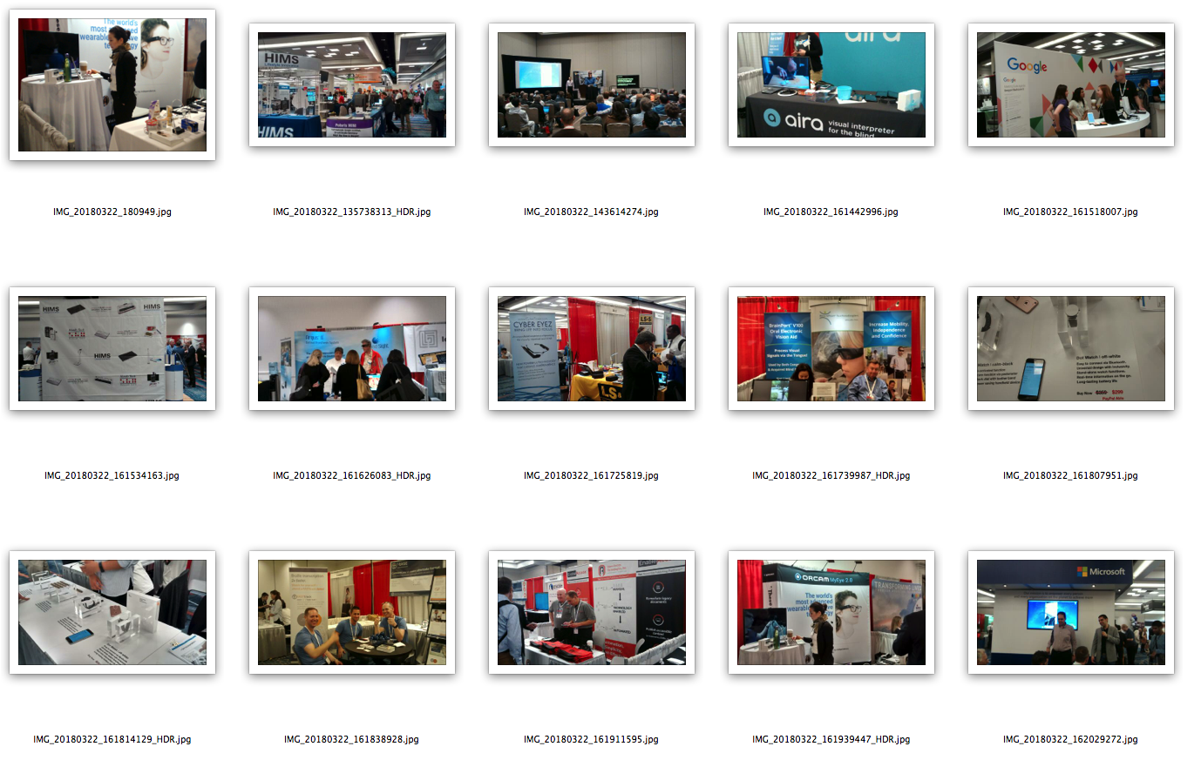
CSUN 2018 Assistive Tech
Orcam MyEye 2.0 HIMs Braille Notetaker Microsoft Accessibility aira – visual interpreter Google Accessibility
HIMs Lifestyle Innovation Argus II Retinal Prosthesis CYBER EYEZ BrianPort Oral Vision Add BLE Dot Watch $299
BLE Dot Watch Braille transcription Open Access Tech, Inc. Orcam MyEye 2.0 Microsoft Demo

Slide 10
Our Goals/Objectives
Goal:
Modeling
Sensing
Mind & Action
for People in Needs
Objectives:
Use multimodal, passive and unobtrusive techniques to help visually impaired people avoid obstacles and perform sign reading.
Study issues in human-machine collaborations in sensing, computing, display (presentation) and action
Compare different approaches for system cost, energy consumption, computational cost and effectiveness

Slide 11
Outline
Background
Course Organization
Highlights of Past Projects
Reading List on MAP-AT
Project Topics of This Year

Slide 12
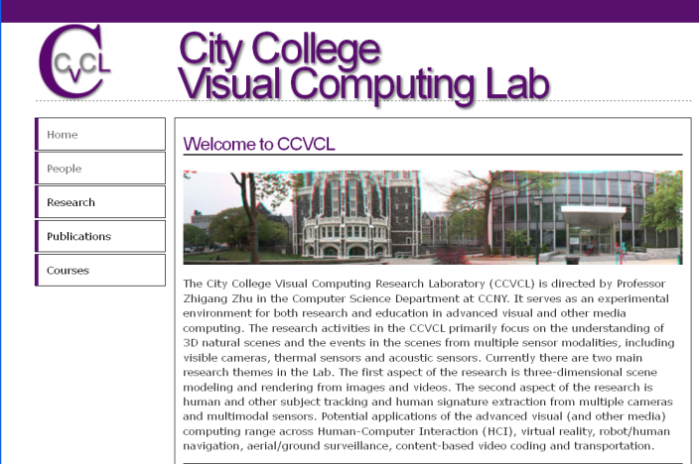






BEAT: Branding and Entrepreneurship of Assistive Technology for Social Good
+
for

Slide 13
Course Assignments – Fall 2019 (Due in 1~2 weeks)
08/31. A1. Resume with Project Topic(s) and Teaming – 10%
09/29. A2. E-Proposals in wiki and quad chart – 10%
10/05. A3. BIC-Proposals shared in wiki or Google Drive – 10%
10/19. P1. Proposal presentations to community partners -15%
10/26. A4. BEAT-Proposals submitted to Zahn Competition – 10%
11/02 & 11/09. A5. Vision Writing Questions (Feature Extraction). – 10%
11/16. A6. Vision Writing Questions (Stereo & Motion). – 10%
11/30. A7. Revised BEAT-Proposals shared in wiki or Drive – 10%
12/07. P2. Revised proposals presented to community partners – 15%

Slide 14
Outline
Background
Course Organization
Highlights of Past Projects (8 years)
Project Topics of This Year

Slide 15
Past Projects (2011 and 2012)
2011-2012 Cohort
1 V.I.S.T.A.: Vibro-tactile Intelligent System for Travelling Aid: a Wearable Alternative (Kaylie First Place)
2. KinDetect: Kinect Detecting Objects (an ICCHP 2012 Paper)
3. LANE: Location and Navigation Evaluation in a Mapped Building Environment
4. Irisπ: an ultra-low-cost solution for the blind in the city
2012-2013 Cohort ->2013 Edition of the NSF Projects to Aid Persons with Disabilities (ed. John Enderle)
5. Smart House for All
6. A Low-cost Outdoor Assistive Navigation System for Blind People
7. Smartphone-Based Indoor Navigation for the Visually Impaired
8. Electronic Travel Aid for the Visually Impaired With a Depth Sensor and Vibrotactile Belt
9. 3D and Image Stitching with the Lytro Light-Field Camera

Slide 16
Past Projects (2011 and 2012)
2011-2012 Cohort
1 V.I.S.T.A.: Vibro-tactile Intelligent System for Travelling Aid: a Wearable Alternative (Kaylie First Place)
2. KinDetect: Kinect Detecting Objects (an ICCHP 2012 Paper)
3. LANE: Location and Navigation Evaluation in a Mapped Building Environment
4. Irisπ: an ultra-low-cost solution for the blind in the city
2012-2013 Cohort ->2013 Edition of the NSF Projects to Aid Persons with Disabilities (ed. John Enderle)
5. Smart House for All
6. A Low-cost Outdoor Assistive Navigation System for Blind People
7. Smartphone-Based Indoor Navigation for the Visually Impaired
8. Electronic Travel Aid for the Visually Impaired With a Depth Sensor and Vibrotactile Belt
9. 3D and Image Stitching with the Lytro Light-Field Camera

Slide 17
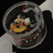
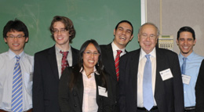
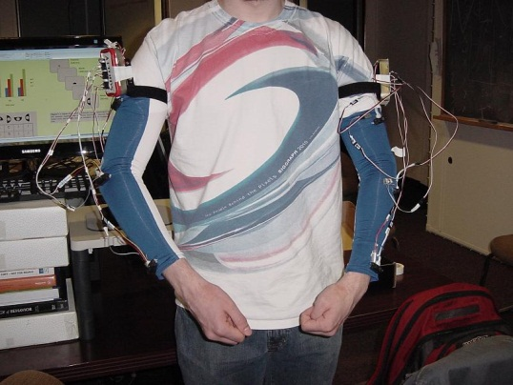
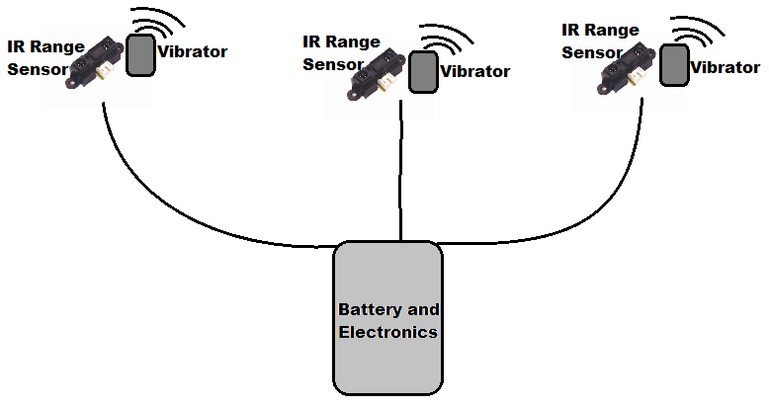
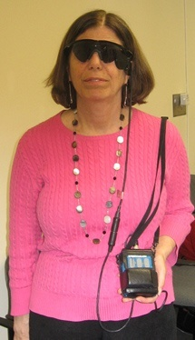
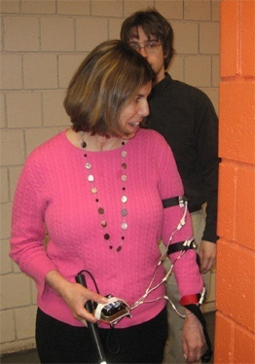
1. Vibro-tactile Intelligent System for Travelling Aid (V.I.S.T.A.) – 2012 Kaylie First Place Winner
Team: Javier Montesino*, Lei Ai+, Cindy Rodríguez*, Frank Palmer*, Daniel Zuleta*
Project Advisors: Dr. Zhigang Zhu*, Dr. Tony Ro+ (*CS/CpE, +Psy)
Eyes of Skin
whole-body wearable range-tactile pairs
Eyes of Skin
– Time, Aug12, 2013
Arm sets on sleeves
Retina implants and IR rangers

Slide 18
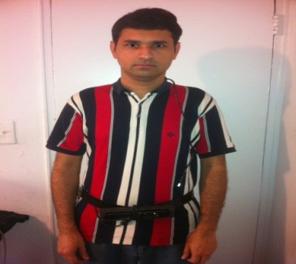
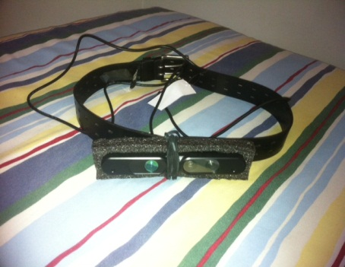
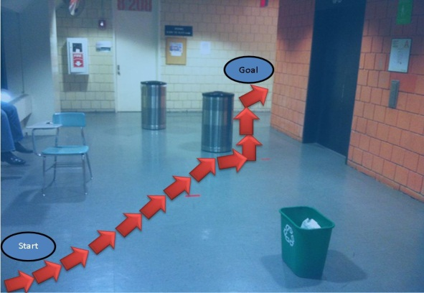
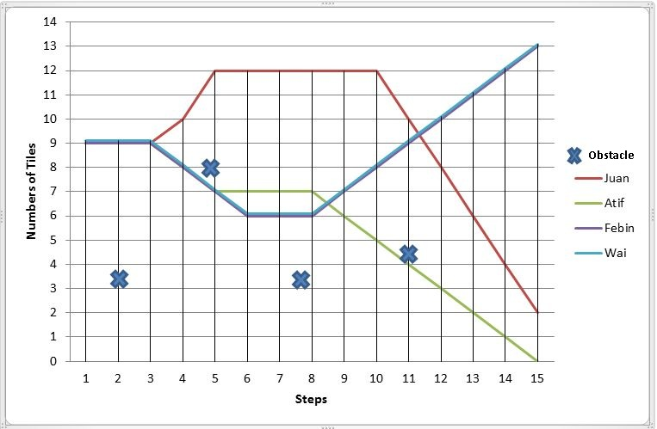
2. KinDetect: Kinect Detecting Objects
Atif Khan, Febin Moideen, Juan Lopez (A Conference Paper)
Project Advisors: Dr. Zhigang Zhu, Wai Khoo
A. Khan, F. Moideen, W. Khoo, Z. Zhu, and J. Lopez, KinDetect: Kinect Detecting Objects , 13th International Conference on Computers Helping People with Special Needs, 7383, Miesenberger, Klaus and Karshmer, Arthur and Penaz, Petr and Zagler, Wolfgang, Springer Berlin Heidelberg, Linz, Austria, July 11-13, 2012 , 588-595

Slide 19
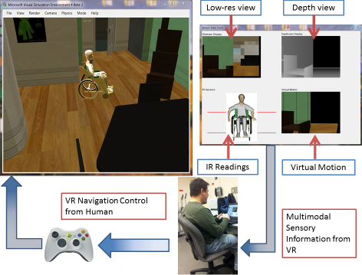
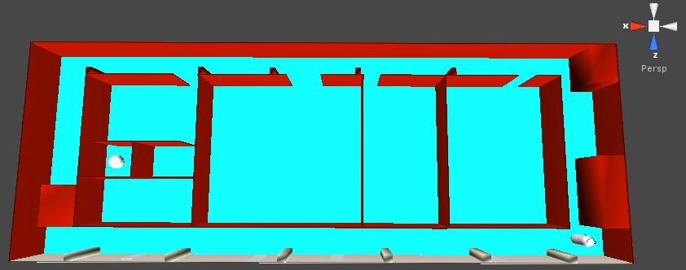
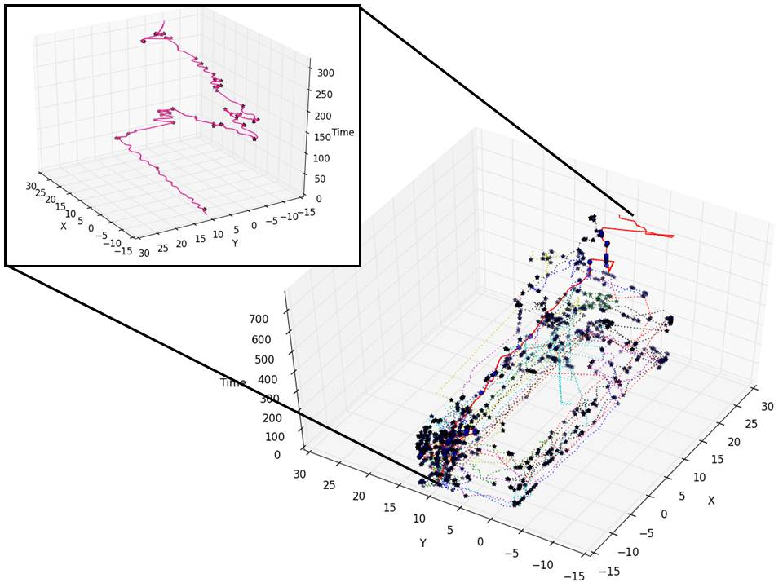
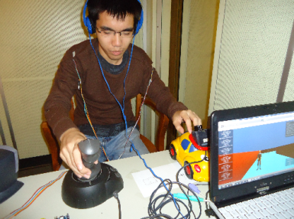
3. Location and Navigation Evaluation in a Mapped Building Environment
Joey Knapp Eric L. Seidel Suri Wigder (lead to a journal paper)
Project Advisors: Wai Khoo, Edgardo Molina, Zhigang Zhu
Microsoft Robotics Studio -> Unity 3D (some work done after capstone)
A complex hall way in VR
Trajectory plots of 18 human subjects
Testing in Unity 3D
Khoo, W. L., Knapp, J., Palmer, F., Ro, T., & Zhu, Z. Journal of Assistive Technologies.

Slide 20


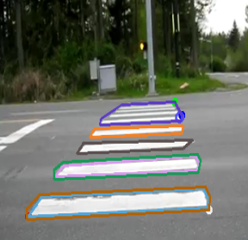
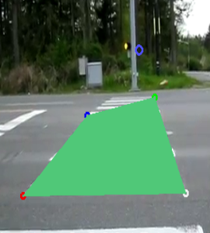
4. Irisπ: an ultra-low-cost solution for the blind in the city
Luis Maurad, Jason Kwong, Jean Sanchez
Project Advisor: Zhigang Zhu, PhD
The Irisπ was built using the following components:
Laptop running Linux (as a replacement for the originally planned Raspberry Pi)
USB Endoscope Camera x2
USB Numeric Keypad
Small Speaker
Sunglasses
Development Tools
OpenCV(C++) v.2.3
Qt Creator
Flite Speech Synthesis System
Gcc Compiler

Slide 21
Past Projects (2011 and 2012)
2011-2012 Cohort
1 V.I.S.T.A.: Vibro-tactile Intelligent System for Travelling Aid: a Wearable Alternative (Kaylie First Place)
2. KinDetect: Kinect Detecting Objects (an ICCHP 2012 Paper)
3. LANE: Location and Navigation Evaluation in a Mapped Building Environment
4. Irisπ: an ultra-low-cost solution for the blind in the city
2012-2013 Cohort ->2013 Edition of the NSF Projects to Aid Persons with Disabilities (ed. John Enderle)
5. Smart House for All
6. A Low-cost Outdoor Assistive Navigation System for Blind People
7. Smartphone-Based Indoor Navigation for the Visually Impaired
8. Electronic Travel Aid for the Visually Impaired With a Depth Sensor and Vibrotactile Belt
9. 3D and Image Stitching with the Lytro Light-Field Camera

Slide 22
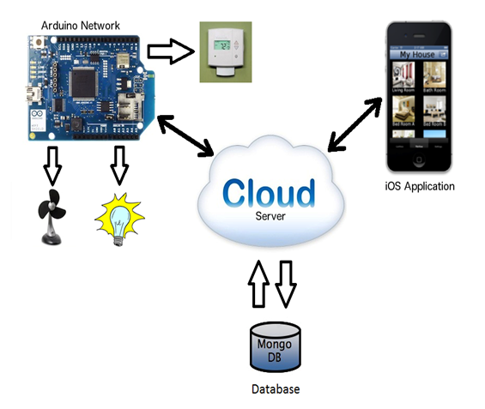
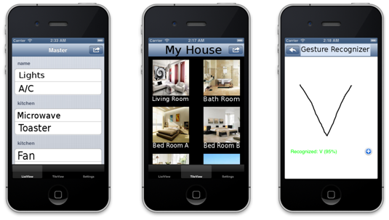
5. Smart House for All
Designers: Karim Abdelrazek , David Leonard, Carlos Chinchilla, Hery Ratsimihah, Michael Klein,Chirag Shah
Client Coordinator: Barbara Campbell, NYS Commission for the Blind
Supervising Professors: Dr. Zhigang Zhu, Department of Computer Science, Dr. Jizhong Xiao, Department of Electrical Engineering
Our iOS app with three types of views: list view, tile view and gesture recognizer

Slide 23
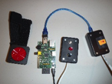
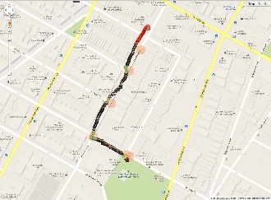
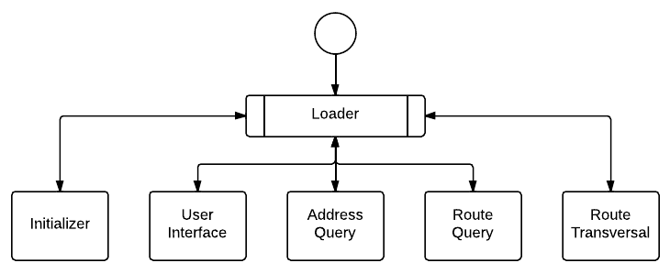
6. A Low-cost Outdoor Assistive Navigation System for Blind People
Designers: Kevin Ramdath, Manor Iosilevish, Dharmdeo Sigh, Anastasis Tsakas
Client Coordinator: Aries Arditi, Visibility Metrics LLC
Supervising Professor: Dr. Jizhong Xiao
Department of Electrical Engineering
Bluetooth GPS receiver, Raspberry Pi, Buttons for user interface.
The navigation result in residential area with reliable GPS signal

Slide 24
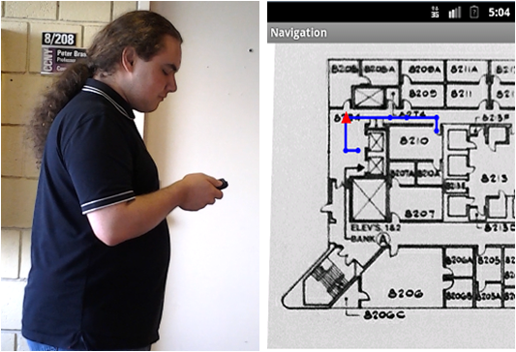
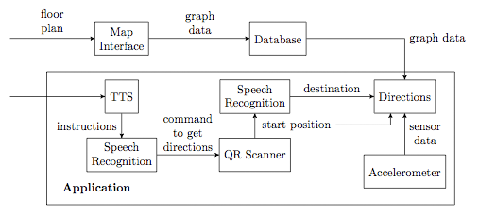
7. Smartphone-Based Indoor Navigation for the Visually Impaired
Designers: Yuriy Stejko, Qiang Wang, Linda Wong
Client Coordinator: Barbara Campbell, NYS Commission for the Blind
Supervising Professor: Dr. Zhigang Zhu
Distance | Average Measured | Error | Standard Deviation
6 m | 6.535 | 8.9% | 0.447
12 m | 12.827 | 6.9% | 0.988
18 m | 18.729 | 4.0% | 0.729
24 m | 24.484 | 2.0% | 0.971
30 m | 29.947 | 0.2% | 1.348
Average distance computed, error, and variance over 20 trials using step detection

Slide 25
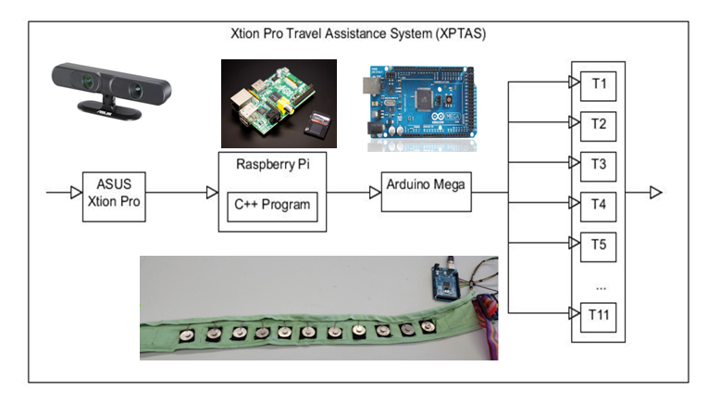
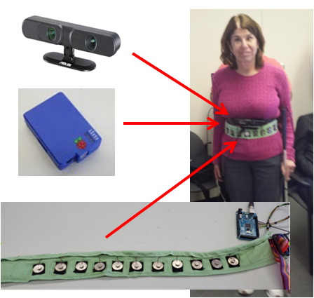
8.Electronic Travel Aid for the Visually Impaired With a Depth Sensor and Vibrotactile Belt
Designers: Raymon Ang, Serge Armond, Gaurav Munjal
Client Coordinator: Barbara Campbell, NYS Commission for the Blind
Supervising Professor: Dr. Zhigang Zhu
Our depth-vibro ETA system: Xtion Pro Depth Sensor (top left), Raspberry Pi with enclosure (middle left), our Vibrotactile belt connected to an Arduino Mega (bottom-left) and testing system on a visually Impaired user (right)

Slide 26
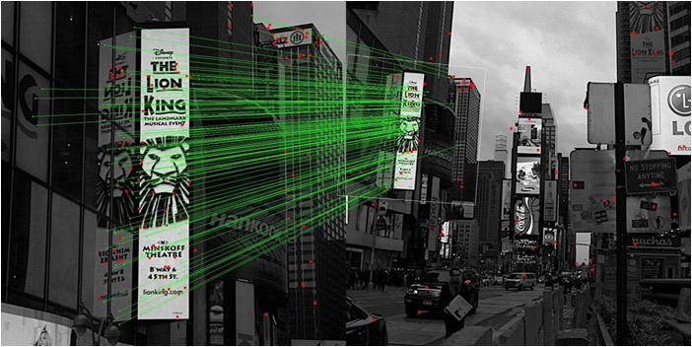
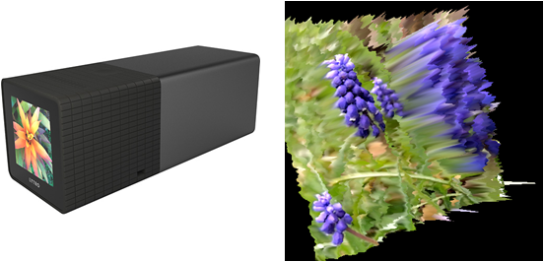
9. 3D and Image Stitching with the Lytro Light-Field Camera
Designers: William Lu, Wan Kim Mok, Jeremy Neiman
Client Coordinator: Barbara Campbell, NYS Commission for the Blind
Supervising Professor: Dr. Zhigang Zhu

Slide 27



CS/CpE/EE/Psy Joint Senior Design Program Fall 2013-Spring 2014 Smart Living and Assistive Technologies for People in Need Instructors: Zhigang Zhu (CS), Jizhong Xiao (EE), Tony Ro (Psy) Projector Mentors: Xudong Li, Edgardo Molina, Wai L. Khoo The City College of New York, NAC 4/115, May 15th (Thursday), 12:00 pm – 3:00 pm A light lunch will be provided. Demos will be shown at the end of the presentations
Time | Presenters | Titles
12:30 pm | Jorge Yau ,Sung Hoon Kim | 3D Sound Graphing
12:45 pm | Keya Bhowmik,Naing Tint, Miron Veryanskiy | Assistive Photography
01:00 pm | Owais Naeem, Luis Disla | Fall Prevention for the Elderly (Kaylie 2nd Prize Team)
01:15 pm | Yeuk Hon Wong | Navigate the web with voice command
01:30 pm | Jason Zhang,Franco Pacheco,Jing Chen | Independent Displacement Tracking
01:45 pm | Carlos Moreaux, Christopher Balisky | Object Detection with 2D Camera
02:00 pm | Jose Chomba, Shaofeng Liu | Blind Reading Text: A mobile application
NSF (Award #1160046) NCIIA (Award #10087-12 )

Slide 28
Fall 2014- Spring 2015
Team 1. SmartCane: Navigation Using Depth Sensor and Novel Alternative Feedback
Team 2 HAST: Health and Support for the Visually Impaired using Angel Open Sensor Wristband (Social Innovation Winner)
Team 3: IndoorMapRGB-D: Indoor Navigation Map Using RGB-D
Team 4: FaceConnect: Face Connect for the Visually Impaired
Team 5: AndriodVE: A Mobile Android Virtual Environment for Cognitive Mapping
Team 6: OWL: Reading On-the-Go for the Blind
Team 7: NFCPublic: NFC Tags to Provide Information in Public Settings Using a Smart Phone
Team 8: GorceryDetect: Grocery Detection for the Blind
Team 9: AutoPhoto: Auto Photography With Guided Focus

Slide 29
Fall 2015- Spring 2016
Team 1. Green Jacket: a website and mobile app pair that helps people with ASD with ordering food in restaurants (CREATE Award)
Team 2 CuraWatch: a time management system designed for community centers and employers who assist in helping ASD inviduals gain and hold onto employment. (CREATE Award)
Team 3: GLEAM: an online therapy model aimed to make mental healthcare more accessible and affordable (Zahn Finalist)
Team 4: QR Navigation: an Android phone app scanning QR Codes in real-time to help ASD individuals navigate (CREATE Award)
Team 5: Hearing Assistive: an Android App helps hearing impaired detect surrounding sound and reduce their chance of injury
Team 6: ASH: help Alzheimer's patients have a more fulfilling social life with their loved ones
Team 7: iBean: an Android App to capture vital signs and location of patients within a health care facility
Team 8: 3D Printing: an Electronics Technician at Makerbot in the 3D printing industry

Slide 30
Fall 2016- Spring 2017
1 Seek and Cross: Zebra Crosswalks and Signal Recognition for VIPs
2 EyeExercise: Improving Vision through Simple Exercises and Better Habits
3 Face Assistant: Identify Loved Ones by Their Faces
4 Mind, Body, Freedom (Zahn Center Competition Finalist)
5 Panoramik: Finding and Locating Objects via Multi-Perspective Camera Technique (CREATE Winner)
6 CCNY Smart Cane (CREATE Winner)
7 VR for ASD: Therapeutic Virtual Environments for Individuals on the Autism Spectrum (CREATE Winner)
8 The Fourth Dimension: Workforce Management System for ASD individuals (CREATE Winner)
9 RescueSenior: Location aware health emergency solution for senior citizens

Slide 31
Fall 2017- Spring 2018
ASSIST (Assistive Sensor Solution for Independent and Safe Travel, by Vishnu Nair and Manjekar Budhai) was in the Spectrum Local News (Manjekar talking at the meeting while Vishnu testing in the field)
AVR4ASD (Augmented and Virtual Reality for Individuals with Autism Spectrum Disorder, by Xinyu Xiong, Rafael Li Chen and Yuxuan Huang) won Second Place Prize of the CREATE Competition (in the picture: Rafael, Xinyu and Prof. Zhigang Zhu).
This is a partnership with Ms. Celina Canvalluzzi, Director of Day Services at Goodwill Industries of Greater New York and Northern New Jersey. More details please see a news release at CCNY.

Slide 32
Capstone 2018-2019
No | Teams | Team Members | Reporting Check Contacts
1 | Indoor.Framework | Jane Chen, Joseph S. | Yaocheng Wu
2 | ARKit Nav | Ben Lin, Jinyun L., | Yaohua Chang
3 | HololensWires | James W., Sebastian P. | Francisco, Hao Tang
4 | ARCore Nav | Jin Zhang, Hanna N., | Yaocheng
5 | VR-Interview | Vincent Yu, Jamie Fung | Kartik
6 | Pre-Journey-VR | David Cao, Hanyu Huang, | MD, Hao Tang
7 | Gesture in VR | Dixon Lu, Haresh S., Areesha R. | Francisco, Hao Tang
8 | VirtualMTA | Lianming Wu, Hongze Wu, | Maui
9 | O3 Joy Music | William G. Chris Huang, Weimin G. | Jizhong Xiao
10 | Nuravine | Sam Mundle, Hugo M. | Alex
11 | EEGStressMeter | Pooneet T., Angelique C., Arslan S. | Hanssel
12 | Smart Cane | Arjun L. | Jizhong Xiao

Slide 33
Capstone 2019-2020
Team Name | Team Member
1. Undaunted: VR for ASD individuals to learn social norms (CREATE) | Abigal B. Carlos S., Raymund R.
2 .ParaShop: Assistive people with ASD in shopping (MIT UTRC//CSUN) | Nan C., Mengting X., Yuemin T.
3. Share&Care: Senior friendly app for fighting loneness (MIT UTRC//CSUN) | Jin C., Xiaohong Z., Yuting Y.
4. VPP: Voice Powered Player for people with mobility disability (Zahn) | Shi-Bin H., Hongzhi P., Xin Z.
5. Worktual Reality: Overcoming social difficulties in conversation (CREATE) | Oscar C., David H., Michael T., Dzhonibek P.
6. Bera: A practical employment analyst for people with Autism (CREATE) (Zahn) | Yorli C., Luis C.,
7. GoodPlan: Interactive activity planning and recommendation for people with ASD (Goodwill) | Xiaoyan Z., Songren Z., Hyo Jun M.
8. GazeIntoView: Training eye contract in interviews. (Zahn) | Krystal L., Fayrouz M., Frank O.

Slide 34
Outline
Background
Course Organization
Highlights of Past Projects
Project Topics of This Year

Slide 35
BEAT for Social Good!
Find topics from users’ needs
Look into the past projects for ideas
http://wiki.ccvcl.org
https://www.nysid.org/create/projects/
(Check out CCNY Teams)
Talk with me for project topics
Align with Zahn competitions
Check conference topics (MIT UTRC, CSUN AT)

Slide 36
Additional Topics Ideas
Zoom attendee video views and eye gazes
Mobile apps to help people
Something you can do at home
ARCore (Android) or ARKit (iOS)
Using Unity3D
Check what past capstone students used

Slide 37
To Do List (Capstone 2020)
Send me your 1-page (!) resume (before 9/08)
Name, Email, Phone and Your Average GPA so far
Education (CS, CpE, and others) & Work Experience
Honors/Awards and Skills
Your Favorite Courses
Your interests of Topics (please list your top 2 choices).
Potential teammates (up to 2 names)
Reading Assignments
Talk with people in needs
Look online for ideas

Slide 38
Outline
Background
Course Organization
Highlights of Past Projects
Project Topics of This Year
Next: Project Demos and Discussions

